Slide 1









Slide 2


Slide 11
IITCA Python Word Excel TnB

Slide 12
IITCA Python Word Excel TnB

Slide 13


Slide 15
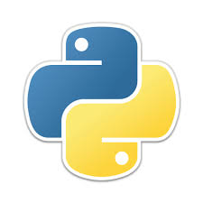
Notes:
Python is an open source, high-level fastest growing programming language that lets you work quickly and integrate systems more efficiently.
When we talk about the history of Python, we cannot miss ABC programming language because it was ABCs influence that led to the design and development of programming language called Python.
Since it was developed in Netherlands so Python invention has its roots in Netherlands itself lets see…

Slide 16
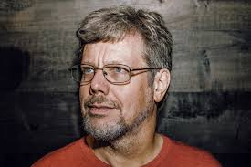
Who Invented Python
Notes:
Guido van Rossum Dutch Scientist
He worked for Netherlands National Research Institute of Mathematics and Computer Science. Over there they used to code in language ABC. Mr. Rossum was bored of that language due to many hiccups in that.
1989 – he was working on hobby programming project to keep him busy during Christmas holidays. He wrote interpreter for New Scripting Language and named it after …………….
Generally in dictionary python is a big snake so most probably Python language inspired from snake but that not true then

Slide 17

Who Invented Python
Notes:
Guido van Rossum Dutch Scientist
He worked for Netherlands National Research Institute of Mathematics and Computer Science. Over there they used to code in language ABC. Mr. Rossum was bored of that language due to many hiccups in that.
1989 – he was working on hobby programming project to keep him busy during Christmas holidays. He wrote interpreter for New Scripting Language and named it after …………….
Generally in dictionary python is a big snake so most probably Python language inspired from snake but that not true then

Slide 20

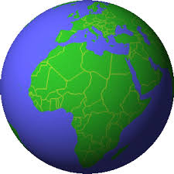

Slide 21
